Slide 1
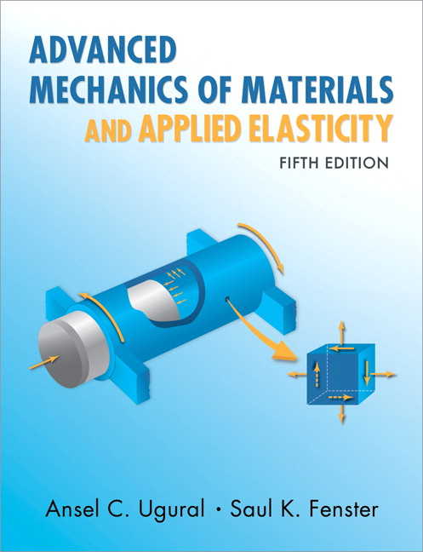
Advanced Mechanics
(Lecture 15)
ANNOUNCE / BUSINESS
HW 6 (due Thursday, 2/27)
HW 7 (due Sat, 3/01) – updated due date
Exam 02: Tuesday, 03/04 Q1: Failure criteria Q2: Contact stresses Q3: Stress concentration
PREVIOUS
Pure bending
TODAY
Asymmetric bending

Slide 2


Bending
Beam: object with one dimension much larger than the other two
Review of pure bending (moment constant along length; no shear stress)
Stress

Slide 3
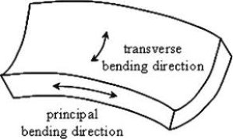




Bending - Strain
$$x$$
Strain
Anticlastic bending
$$y$$
$$ρ$$
$$θ$$

Slide 4
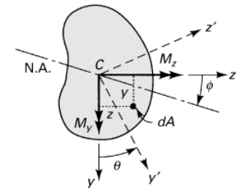


Asymmetric Bending
Equation of neutral axis
Note that the angle of the N.A. is dependent upon both the loading and the cross-sectional properties

Slide 5

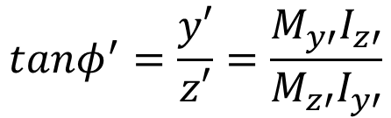

Asymmetric Bending
(true for symmetrical shapes when coords are aligned with axis of symmetry)
If $I_{yz}=0$,
(where the primed variables correspond with the principal axes of the section)
$$tanφ^{′}=\frac{y′}{z′}=\frac{M_{y′}I_{z′}}{M_{z′}I_{y′}}$$

Slide 6
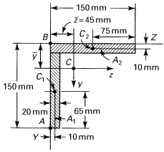
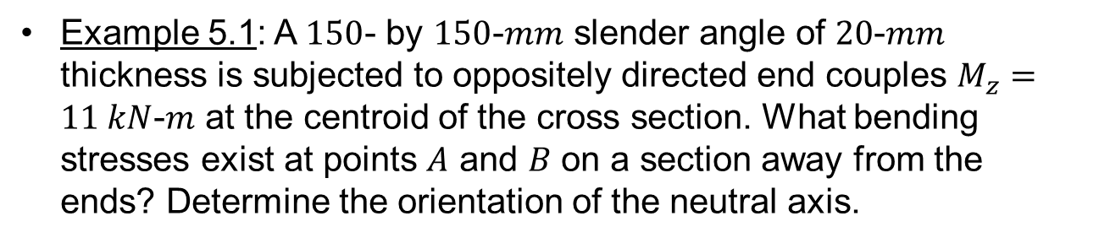
Example 5.1: A $150$- by $150$-$mm$ slender angle of $20$-$mm$ thickness is subjected to oppositely directed end couples $M_{z}=11 kN$-$m$ at the centroid of the cross section. What bending stresses exist at points $A$ and $B$ on a section away from the ends? Determine the orientation of the neutral axis.

Slide 7
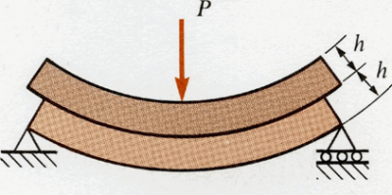
Shear Stress
Often ignored during failure analysis since it is small compared to normal stress in typical beams; becomes more important for short, stubby beams
Still plays important role in constraining bending of long beams
Notes:
right middle: show that for distributed load case application of stacked beam scenario, a beam with height 2h has ¼ the deflection of two beams with height h stacked on top of each other

Slide 8
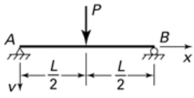

Shear Stress
Exercise: compare deflections of two stacked beams (left)
Notes:
right middle: show that for distributed load case application of stacked beam scenario, a beam with height 2h has ¼ the deflection of two beams with height h stacked on top of each other

Slide 9

How do we quantify shear stress in bending beams?

